Slide 1
IT Research Methods
Chapter 1
Introduction, Acquiring Knowledge and the Scientific Method
Prof Kennedy Njenga

Slide 2
1.1 Methods of Knowing and Acquiring Knowledge
Nonscientific approaches
  Method of tenacity
  Method of intuition
  Method of authority
  Rational method
  Method of empiricism
Scientific method
  Goal is to obtain better-quality answers

Slide 3
Methods of Tenacity
What is tenacity?
  Information accepted as true because it has always been believed or because superstition supports it.
  Limitations: potential inaccuracies; no method for correcting erroneous ideas.

Slide 4
Methods of Intuition
What is intuition?
  Information accepted on the basis of a hunch.
  Limitation: no method for separating accurate from inaccurate knowledge.

Slide 5
Methods of Authority
Relies on information or answers from an expert in the field.
Good starting point—often quickest and easiest way to obtain answers.
Some limitations:
  Does not always provide accurate information.
  Often accepts expert’s statements as fact (method of faith).
  Not all “experts” are experts.

Slide 6
The Rational Method
What is an example of seeking answers by logical reasoning?
  All 3-year-old children are afraid of the dark.
  Amy is a 3-year-old girl.
  Therefore, Amy is afraid of the dark.
In the above argument:
  First two sentences are premise statements;
  Final sentence is a logical conclusion based on the premises.

Slide 7
Limitations to the Rational Method
Logical conclusions are only valid if the premise statements are true.
  The rational method “assumes” the premise statements are true.
People are not very good at logical reasoning.
  Sometimes the argument does not logically support the conclusion.

Slide 8
The Empirical Method
Also known as empiricism: answering questions by direct observation or personal experience.
  Based on the philosophy that all knowledge is acquired through the senses.
Limitations
  Observations can be misinterpreted (Figure 1.1).
  Sensory experience can be swayed by beliefs.
  Time-consuming and sometimes dangerous.

Slide 9

The Horizontal-Vertical Illusion

Slide 10
Summary of Nonscientific Methods of Acquiring Knowledge
Method | Way of Knowing or Finding Answer
Tenacity | From habit or superstition
Intuition | From a hunch or feeling
Authority | From an expert
Rationalism | From reasoning; a logical conclusion
Empiricism | From direct sensory observation

Slide 11
1.2 The Scientific Method
An approach to acquiring knowledge
  involves formulating specific questions and then systematically finding answers;
  combines several different methods of acquiring knowledge.

Slide 12
The Steps of the Scientific Method
Observe behavior or other phenomena.
Form a tentative answer or explanation (a hypothesis).
Use your hypothesis to generate a testable prediction.
Evaluate the prediction by making systematic, planned observations.
Use the observations to support, refute, or refine the original hypothesis.

Slide 13
Inductive and Deductive Reasoning
What is induction?
  A small set of specific observations is the basis for forming a general statement about a larger set of possible observations.
  Induction = increase
What is deduction?
  A general statement is the basis for reaching a conclusion about specific examples.
  Deduction = decrease

Slide 14
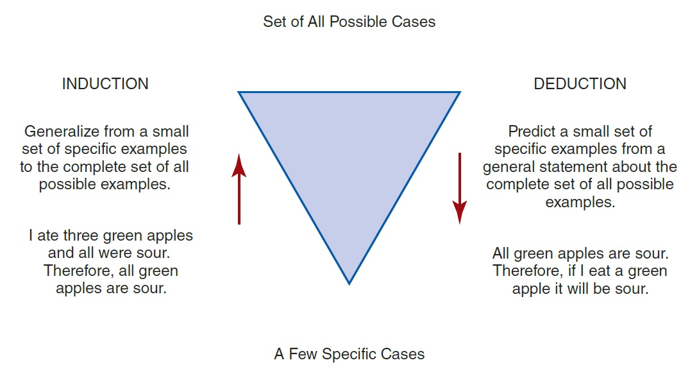
Examples of Induction and Deduction

Slide 15
Variables and Hypothesis
Variables: characteristics or conditions that change or have different values for different individuals.
  Examples: weather, health status, and age.
What is a hypothesis?
  A statement that describes or explains a relationship between variables; “best guess.”
    A hypothesis can lead to several different observable and measureable predictions.

Slide 16
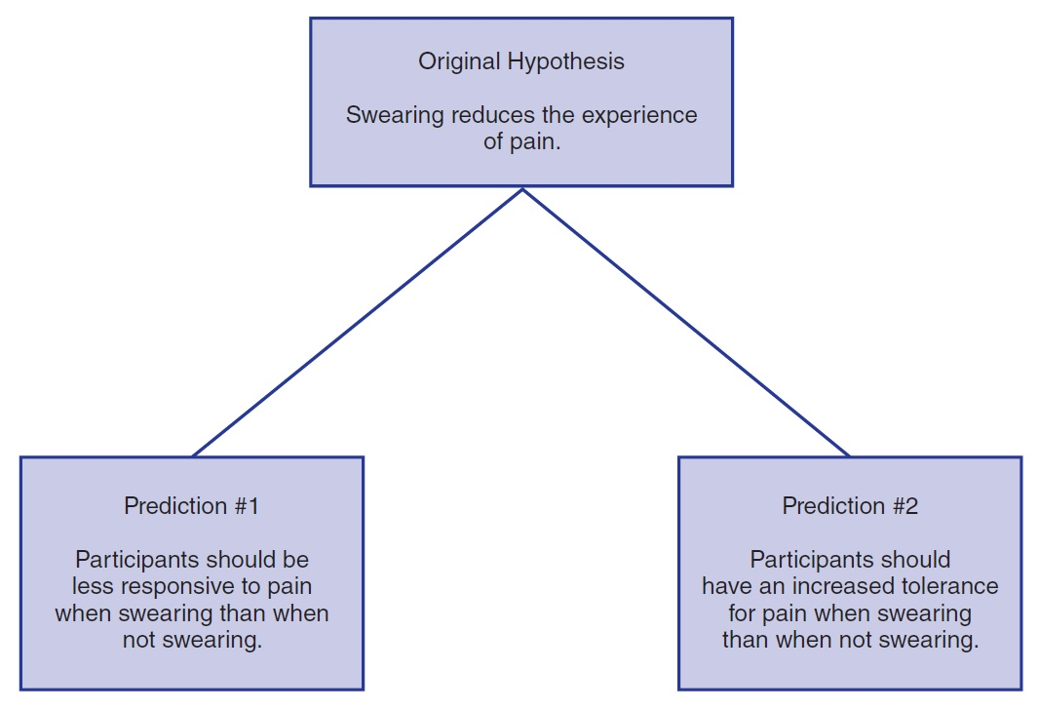
Two Testable Predictions Derived from a General Hypothesis

Slide 17
Three Important Principles of the Scientific Method
It is empirical.
It is public.
It is objective.

Slide 18
Science is Empirical and Public
Empirical: Answers are obtained by making structured or systematic observations.
  Results will provide clear support for the hypothesis or will clearly refute the hypothesis.
Public: Observations are available for evaluation by others.
  Replication is key to the scientific method.
Objective: Outcome is not skewed by bias.

Slide 19
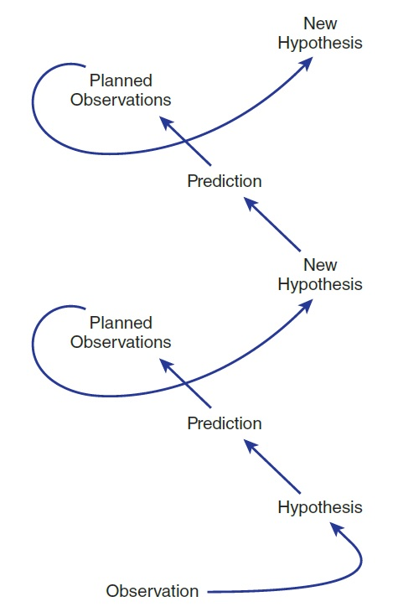
The Process of Scientific Inquiry

Slide 20
Science versus Pseudoscience
Basis of scientific research
  Evidence is gathered from careful, systematic, and objective observations.
Pseudoscience is a system of ideas often presented as science.
  Lacks some of the key components essential to scientific research.
  Examples: aromatherapy, astrology, and intelligent design.

Slide 21
1.3 The Research Process
What distinguishes qualitative research and quantitative research?
  Quantitative research produces numerical scores.
    Submitted to statistical analysis for summary and interpretation
  Qualitative research is based on making observations.
    Summarized and interpreted in a narrative report

Slide 22
The Steps in the Research Process (1 of 2)
Find a research idea: select a topic and search the literature to find an unanswered question.
Form a hypothesis.
Determine how you will define and measure your variables.
Identify the participants or subjects for the study, decide how they will be selected, and plan for their ethical treatment.
Select a research strategy.

Slide 23
The Steps in the Research Process (2 of 2)
Select a research design.
Conduct the study.
Evaluate the data.
Report the results.
Refine or reformulate your research idea.

